Slide 1

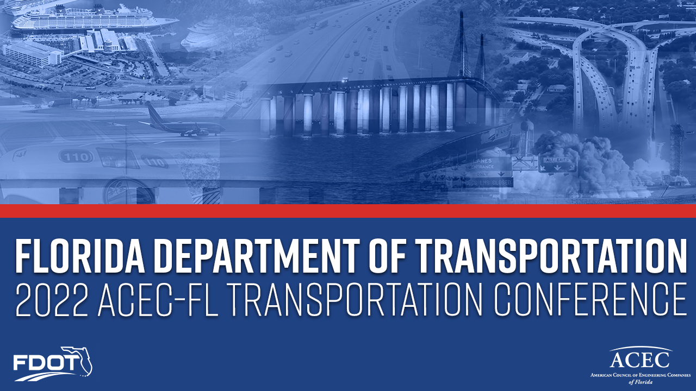

13th Annual Conference
November 15-17, 2022
Sarasota
Florida Department of Transportation
Secretary Jared W. Perdue, P.E.

Slide 2
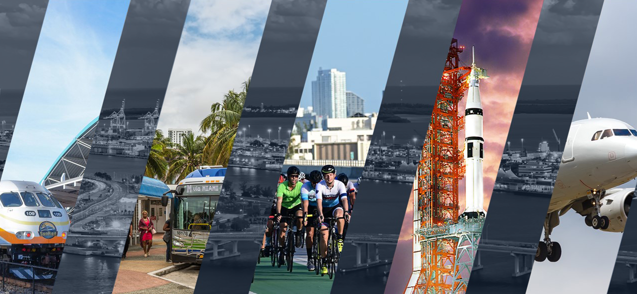

Slide 3
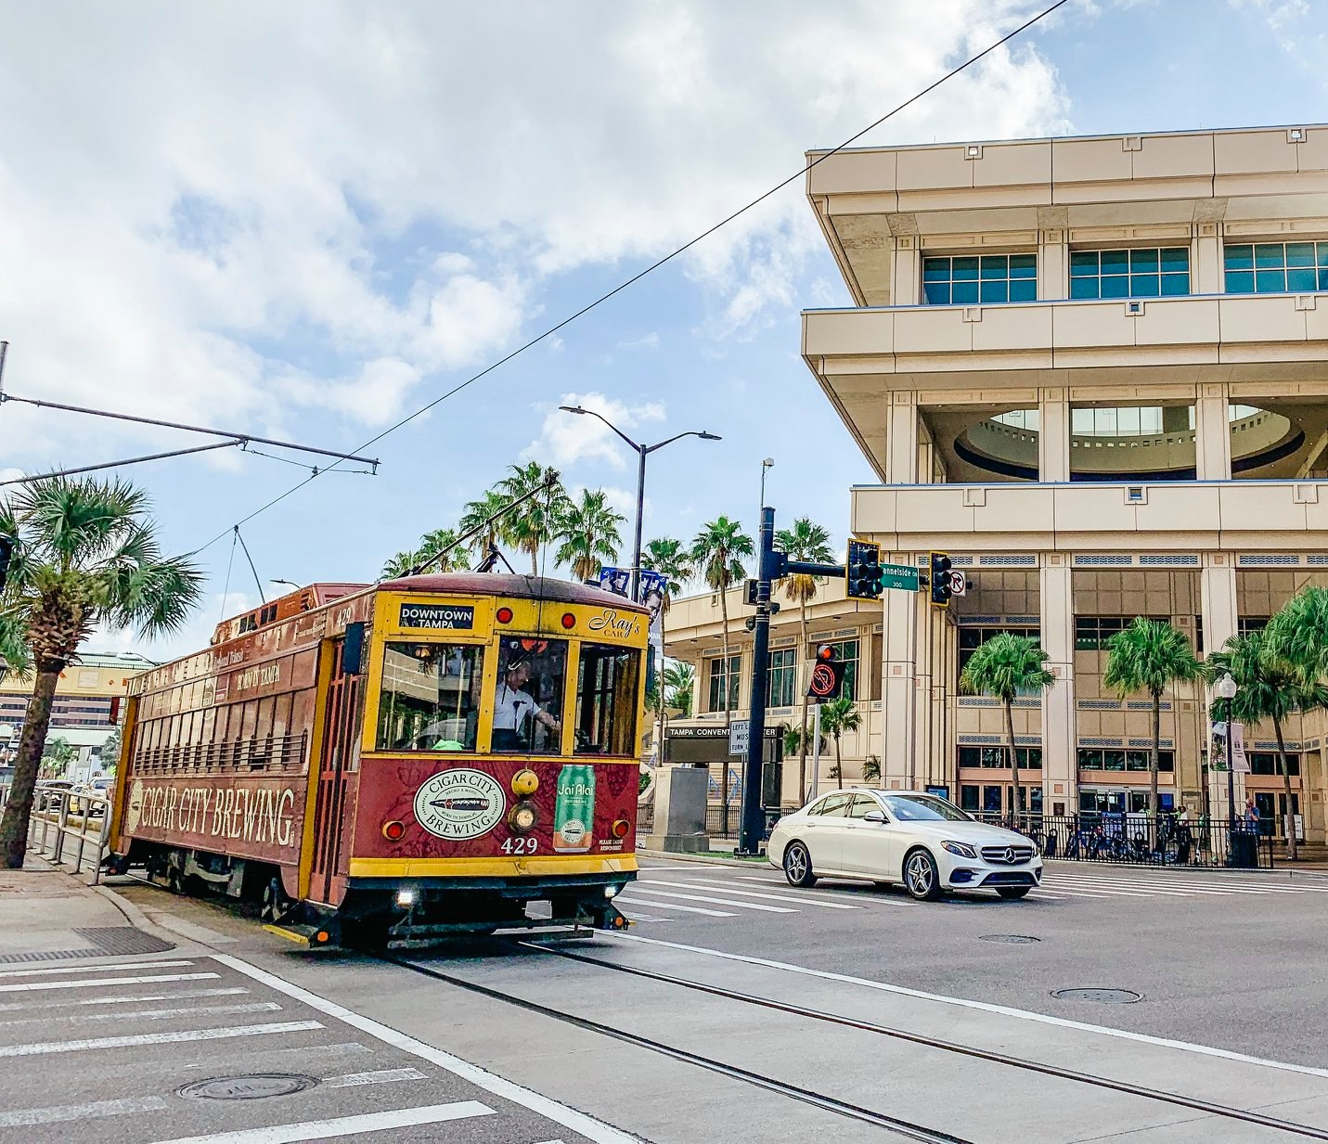
Embracing
Communities

Slide 4

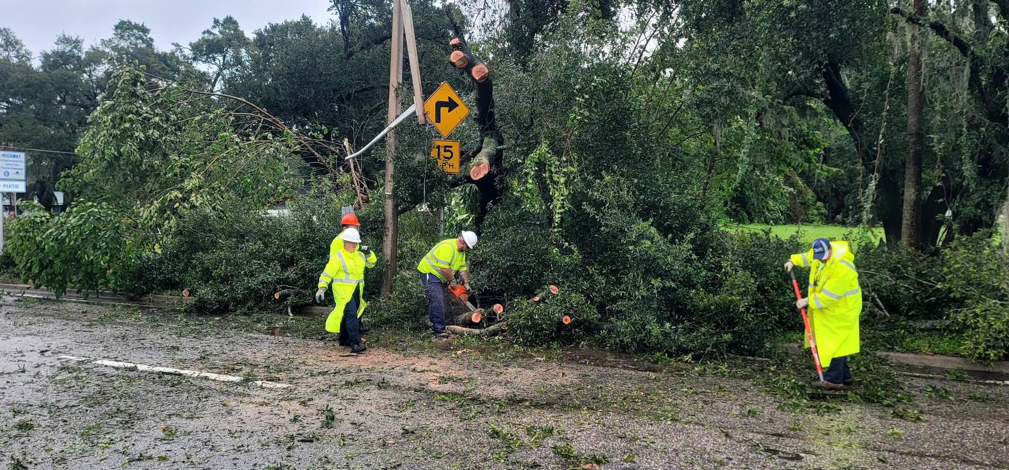
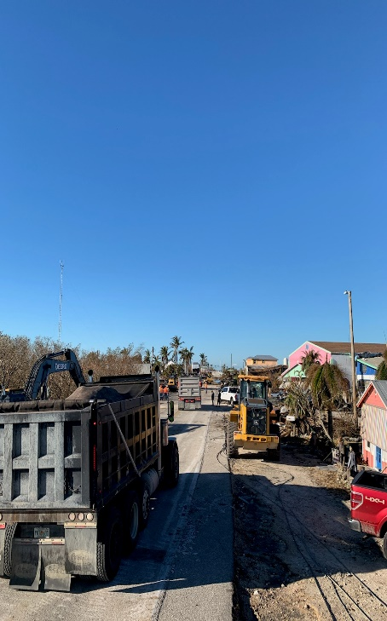
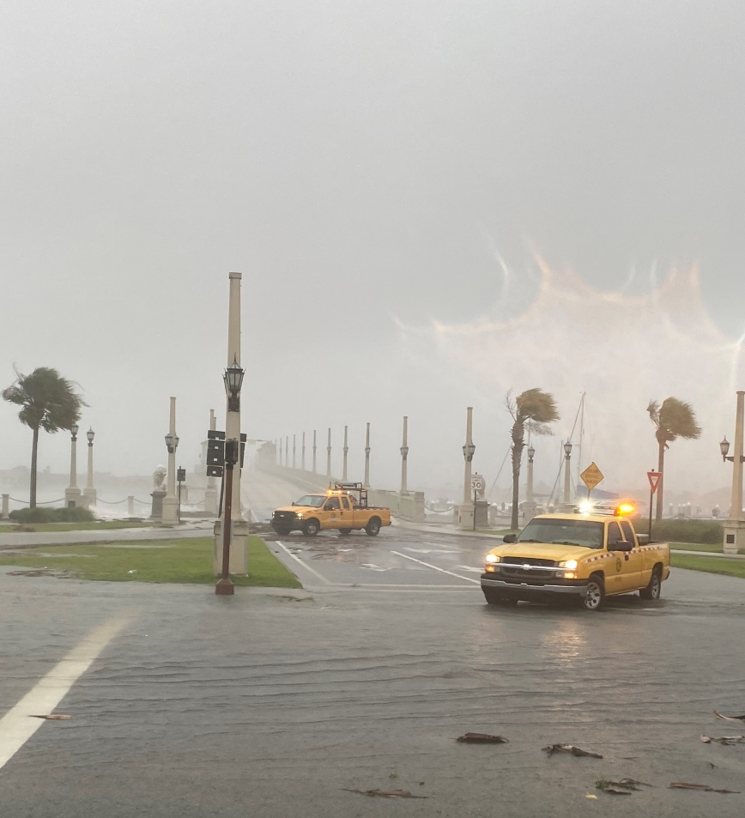
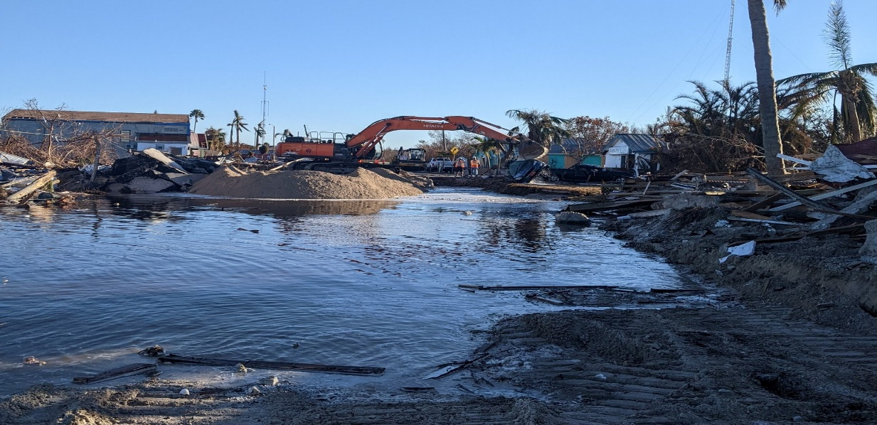
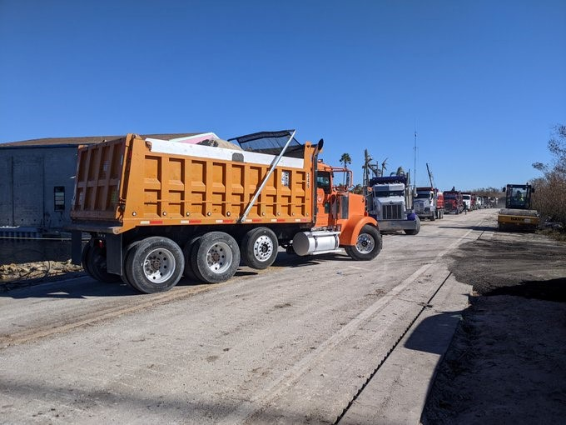
Hurricane Preparation and Recovery

Slide 5

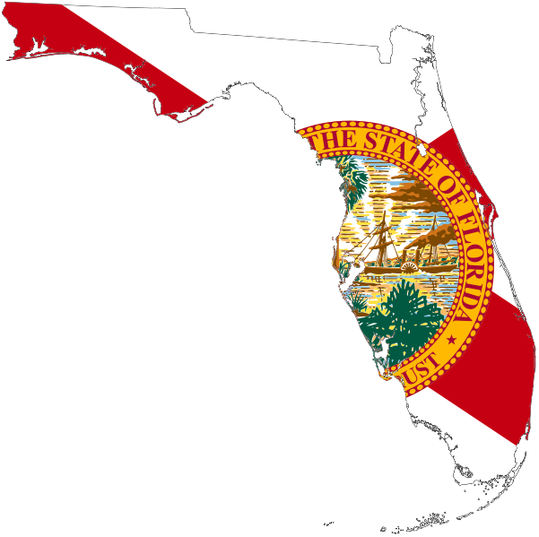
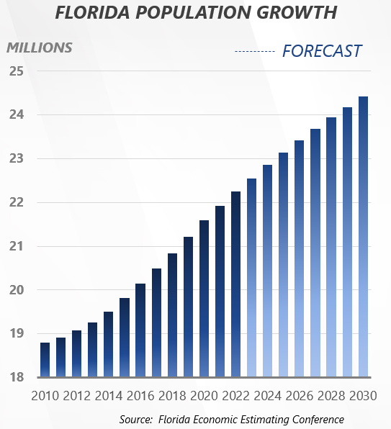
A Growing Challenge, Florida’s Population
60%
of Florida’s population growth
is concentrated in 10 counties
Osceola
St. Johns
Sumter
Walton
Lake
Orange
Santa Rosa
Manatee
Nassau
Lee

Slide 6

Investing in Florida Transportation
Largest FDOT Budget in History: $12.6 Billion
$4.4 Billion in Highway Construction; Adding 307 New Lane Miles
$236.6 Million Bridge Maintenance Repairs and Replacements
$1.2 Billion Resurfacing 3,033 Lane Miles
Investing Beyond Roads:
Seaports $135.9 Million
Aviation $252.7 Million
Transit $672.8 Million
Spaceports $61.8 Million
Rail/Freight $194.3 Million

Slide 7
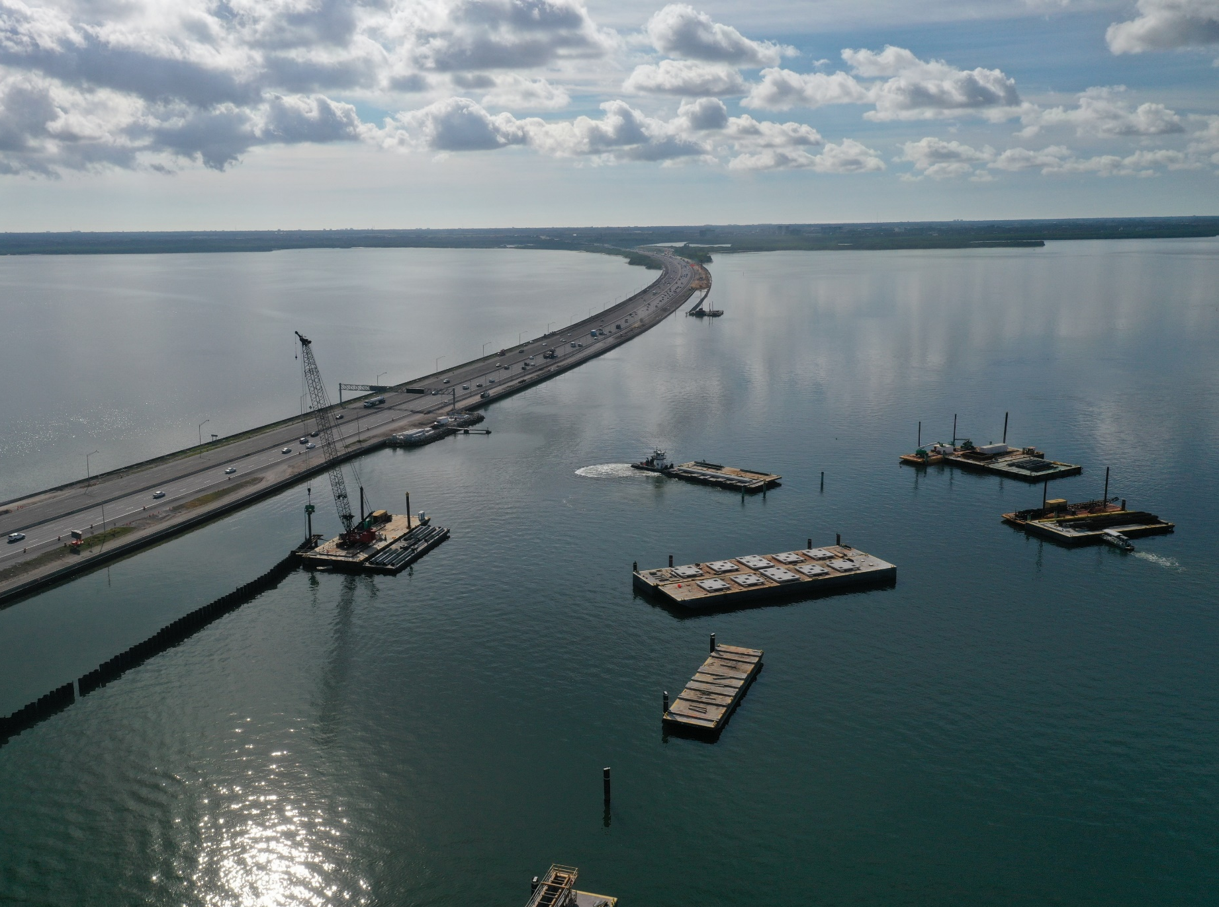
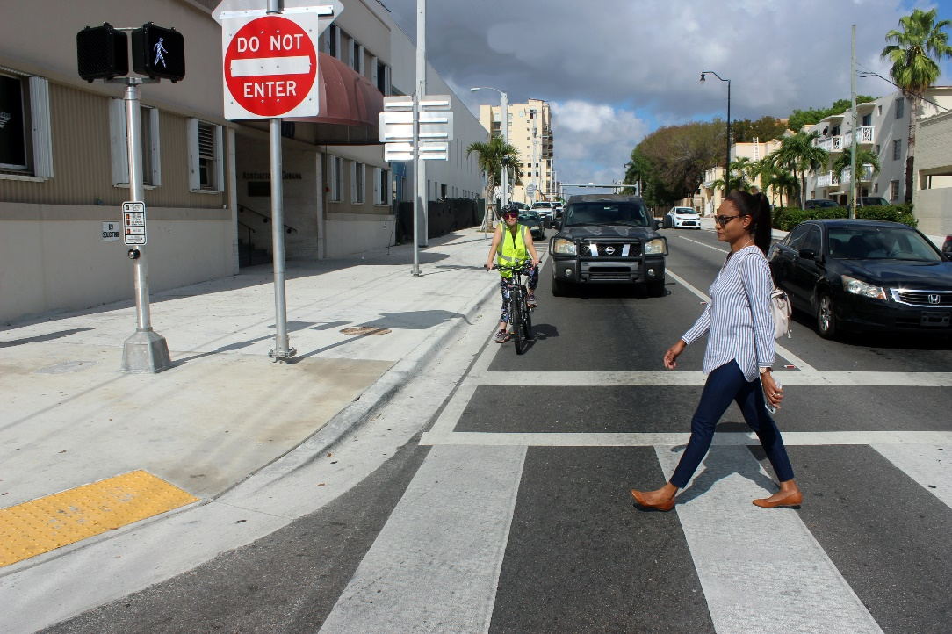
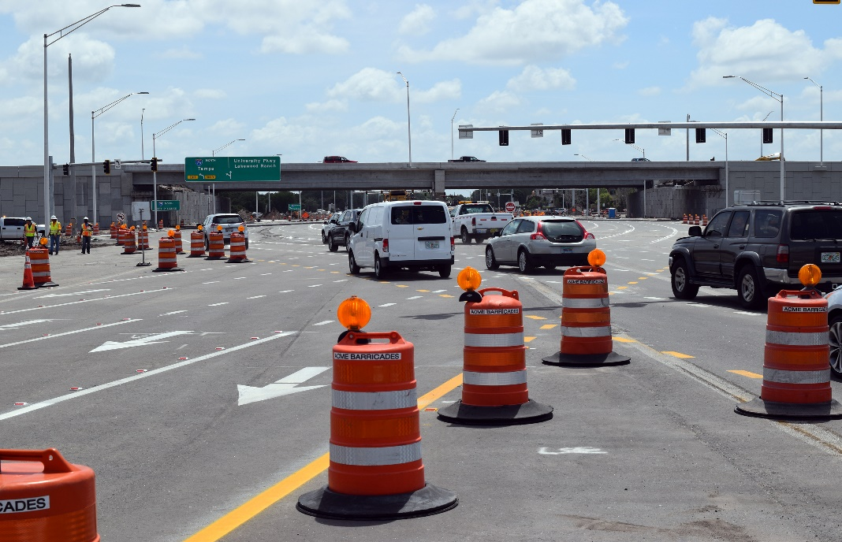
Targeted Solutions: Strategic Projects

Slide 8
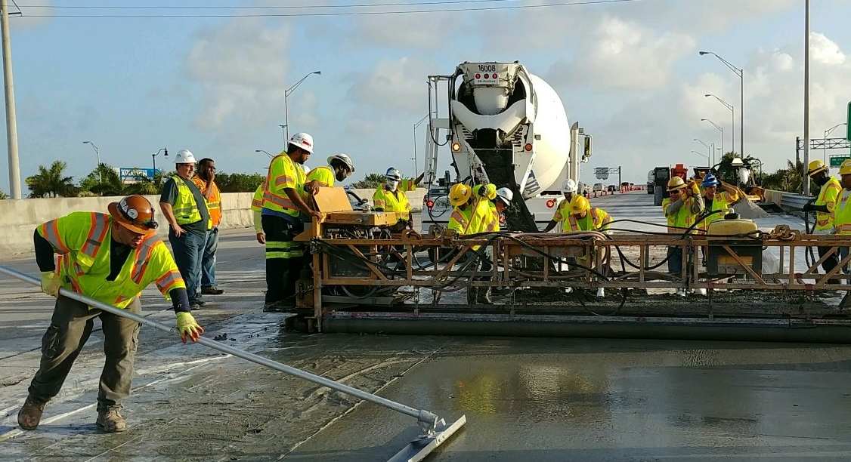
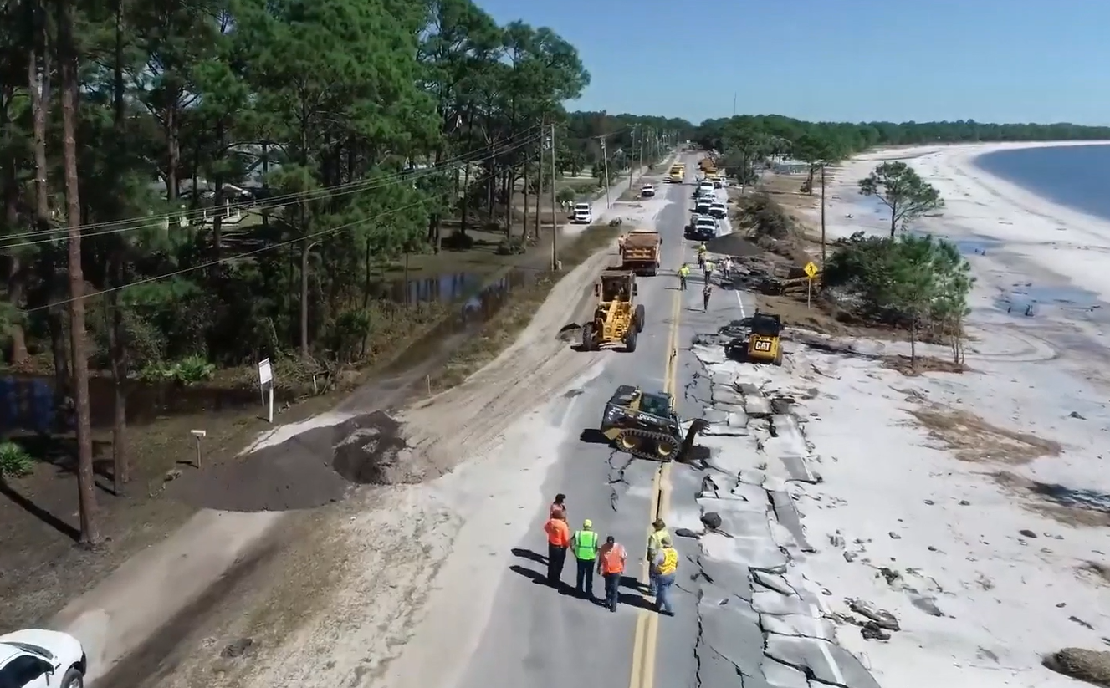
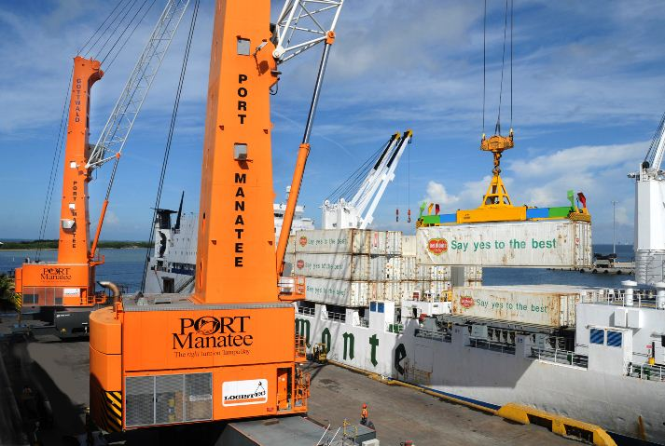
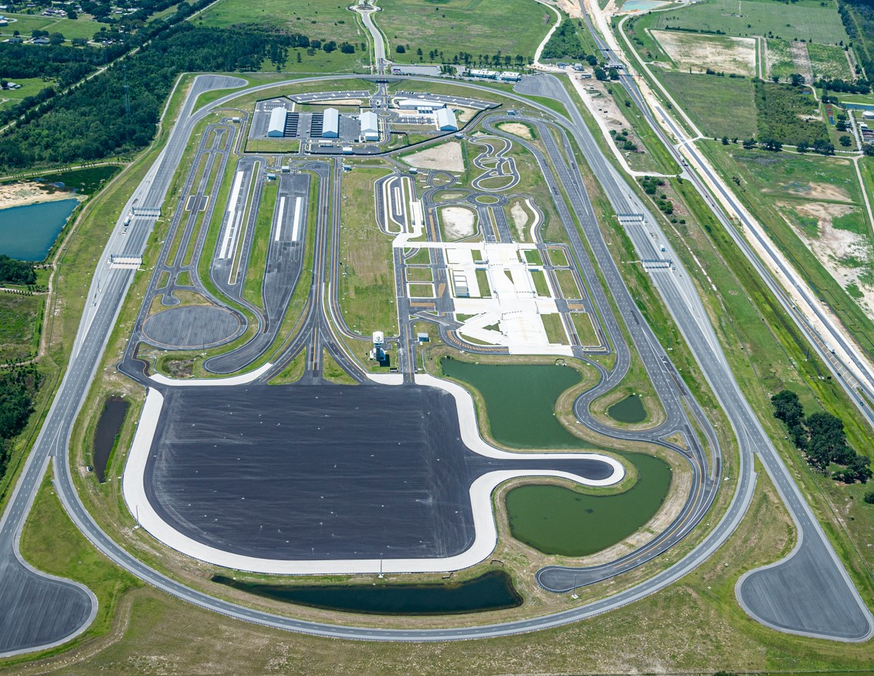
Strategic Focus Areas

Slide 9
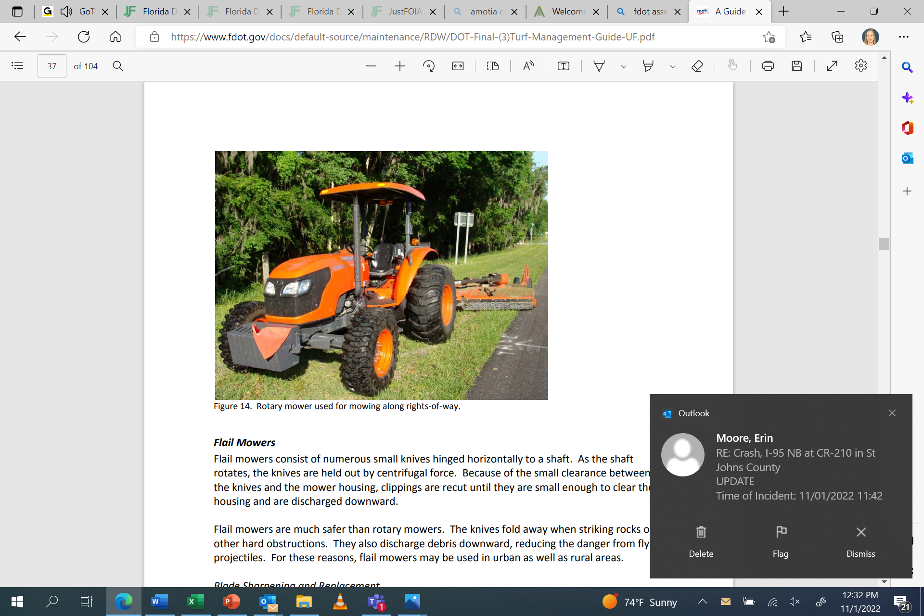
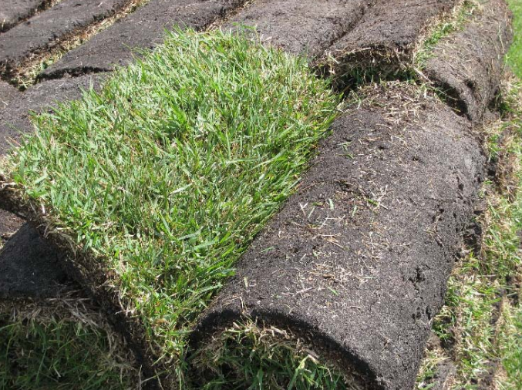
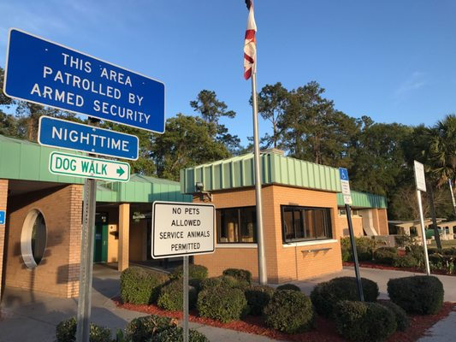
Importance of Asset Maintenance

Slide 10






On Florida’s
Roads
Daily Fatalities
Daily Serious Injuries
The Majority of Crashes Involve Driver behavior
As a Contributing Factor…
WHY?

Slide 11

Questions

